Slide 1
CASE STUDIES

Slide 2
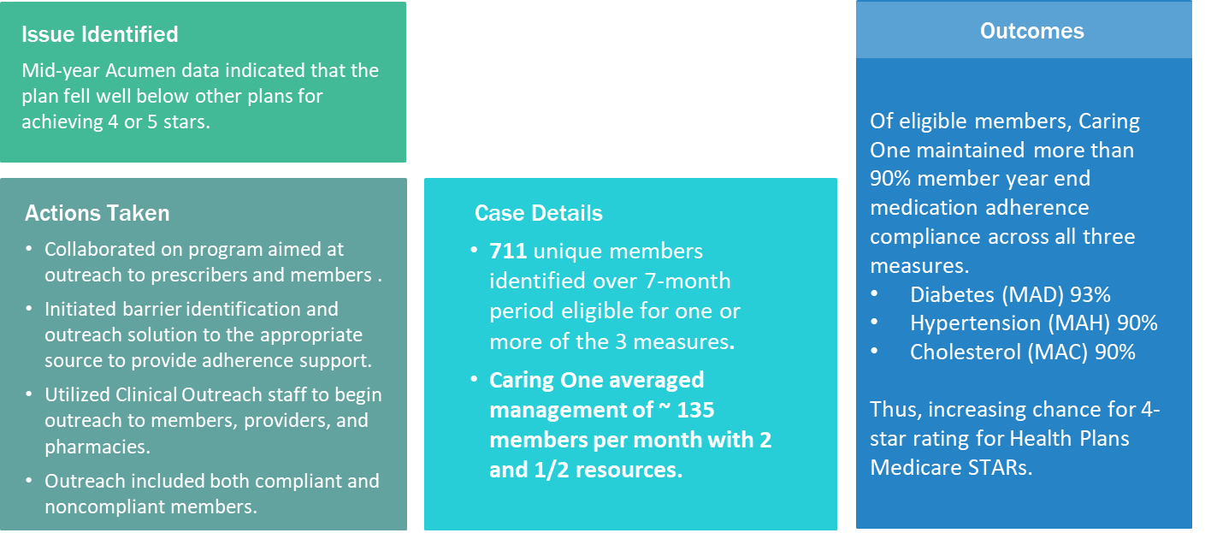
Case Study: Medication Adherence STAR Measures (MAD, MAH, MAC)
Health Plan (5,000 lives – Medicare DSNP)
MEDICATION ADHERENCE OUTCOMES

Slide 3
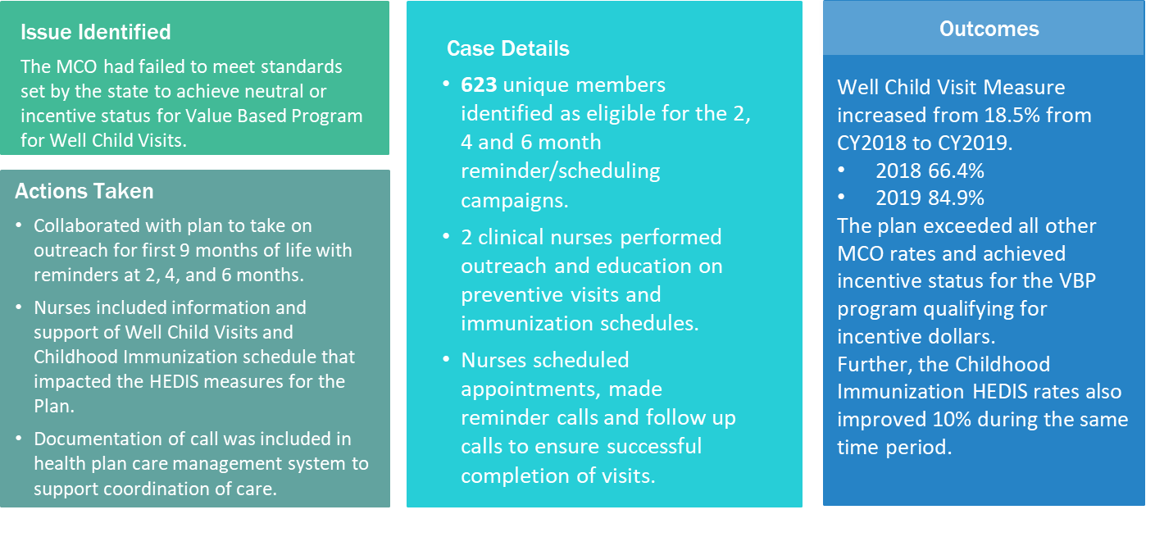
Case Study: Well Child Visits and Childhood Immunization Reminders Health Plan (50,000 lives – Medicaid MCO)
WELL CHILD VISITS OUTCOMES

Slide 4
Based on the experience of Premier Medical and its affiliates, CMG and First Call, your healthcare business is likely to experience the following within the first six (6) months of using Caring One:
The Number of Patients seen will increase by 15%. Your practice may have been growing at a lower rate but Caring One allows you to have more inquiries answered timely and more appointments can be made.
Your Net Promoter Score will increase—with no negative experience. Your practice could achieve a score of 86, meaning that 8.6 persons out of ten are actively promoting your practice.
You will experience an annualized return on investment of 70% in the first year. Your ROI can be based on the fees you pay Caring One and your increased profit.
Caring One has the capacity to scale up, onboarding new personnel and using a train-the-trainer approach. Only train us once!
We grow with you!

Slide 5
For additional information, please contact:
Kyle D. Richardson
President
561-504-2544
kyle.richardson@caring-one.biz

